Slide 1
No comment
no

Slide 2
Preface:
It contains an entire chapter devoted to differential equations and complete sections on Newton’s method, surface area of solids of revolution, hyperbolic functions, and integration strategies. This book is an extended version of Calculus: Early Transcendentals by the same authors. This textbook supports a three-semester or four-quarter calculus sequence typically taken by students in mathematics, engineering, and the natural sciences.

Slide 3
Pedagogical Features:
linked directly to a block of Basic Skills exercises via Related Exercises references at the end of the example solution, Further Explorations exercises expand on the Basic Skills exercises by challenging students to think creatively and to generalize newly acquired skills, Applications exercises connect skills developed in previous exercises to applications and modeling problems that demonstrate the power and utility of calculus, Additional Exercises are generally the most difficult and challenging problems; they include proofs of results cited in the narrative, Each chapter concludes with a comprehensive set of Review Exercises .

Slide 4
Quick Check and Margin Notes:
The narrative is interspersed with Quick Check questions that encourage students to read with pencil in hand.

Slide 5
Guided Projects:
These projects allow students to work in a directed, step-by- step fashion, with various objectives: to carry out extended calculations, to derive physical models, to explore related theoretical topics, or to investigate new applications of calculus.

Slide 6
Technology:
Throughout the book, exercises marked with T indicate that the use of technology— ranging from plotting a function with a graphing calculator to carrying out a calculation using a computer algebra system—may be needed

Slide 7
eBook with Interactive Figures:
Instructors can use these interactive figures in the classroom to illustrate the important ideas of calculus, and students can explore them while they are reading the textbook. The authors have written Interactive Figure Exercises that can be assigned via MyMathLab so that students can engage with the figures outside of class in a directed way.

Slide 8
Content Highlights:
We made organizational changes to the standard presentation of these topics or slowed the pace of the narrative to facilitate students’ comprehension of material that is traditionally difficult. By splitting this material into two chapters, we have given these topics a more deliberate pace and made them more accessible without adding significantly to the length of the narrative.

Slide 9
Accuracy Assurance:
In this expanded version, we have incorporated improvements recommended by professors using the initial version of this book at colleges and universities across the country. In developing the predecessor to this book, more than 200 mathematicians reviewed the manuscript for accuracy, level of difficulty, and effective pedagogy.

Slide 10
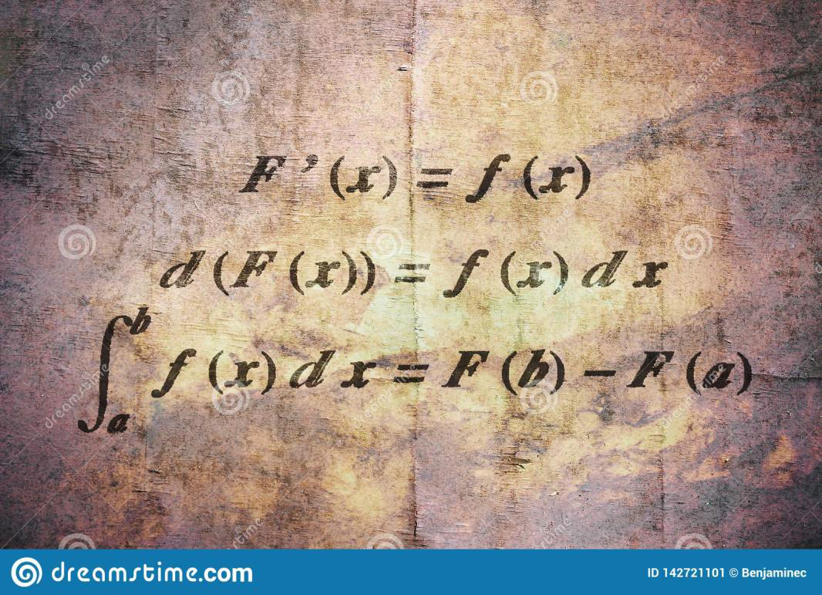

Slide 11
Functions:
The goal of this chapter is to ensure that you begin your calculus journey fully equipped with the tools you will need. Here, you will see the entire cast of functions needed for calculus, which includes polynomials, rational functions, algebraic functions, exponential and logarithmic functions, and the trigonometric functions, along with their inverses. It is imperative that you work hard to master the ideas in this chapter and refer to it when questions arise.

Slide 12
Review of Functions:
The graph of a function f is the set of all points 1 x , y 2 in the xy -plane that satisfy the equation y = f 1 x 2. Calculus is the study of functions, and because we use functions to describe the world around us, calculus is a universal language for human inquiry The independent variable is the variable associated with the domain; the dependent variable belongs to the range. Similarly, 2 is the argument in f 122 and x 2 + 4 is the argument in f 1 x 2 + 42.

Slide 13
Limits:
As the chapter progresses, we build more rigor into the definition of the limit, and we examine the different ways in which limits exist or fail to exist. Derivatives enable us to talk about the instantaneous rate of change of a function, which, in turn, leads to concepts such as velocity and acceleration, population growth rates, marginal cost, and flow rates.

Slide 14
The Idea of Limits:
This brief opening section illustrates how limits arise in two seemingly unrelated problems: finding the instantaneous velocity of a moving object and finding the slope of a line tangent to a curve. These two problems provide important insights into limits, and they reappear in various forms throughout the book.

Slide 15
Average Velocity:
Suppose you want to calculate your average velocity as you travel along a straight highway. If you pass milepost 100 at noon and milepost 130 at 12:30 p.m., you travel 30 mi in a halfhour, so your average velocity over this time interval is 130 mi2>10.5 hr2 = 60 mi>hr. By contrast, even though your average velocity may be 60 mi> hr, it’s almost certain that your instantaneous velocity, the speed indicated by the speedometer, varies from one moment to the next.

Slide 16
Techniques for Computing Limits:
Graphical and numerical techniques for estimating limits, like those presented in the previous section, provide intuition about limits. These techniques, however, occasionally lead to incorrect results. Therefore, we turn our attention to analytical methods for evaluating limits precisely.

Slide 17
Infinite Limits:
The other type of limit, known as a limit at infinity, occurs when the independent variable x increases or decreases without bound.

Slide 18
Precise Definitions of Limits:
The limit definitions already encountered in this chapter are adequate for most elementary limits. However, some of the terminology used, such as sufficiently close and arbitrarily large , needs clarification. The goal of this section is to give limits a solid mathematical foundation by transforming the previous limit definitions into precise mathematical statements.

Slide 19
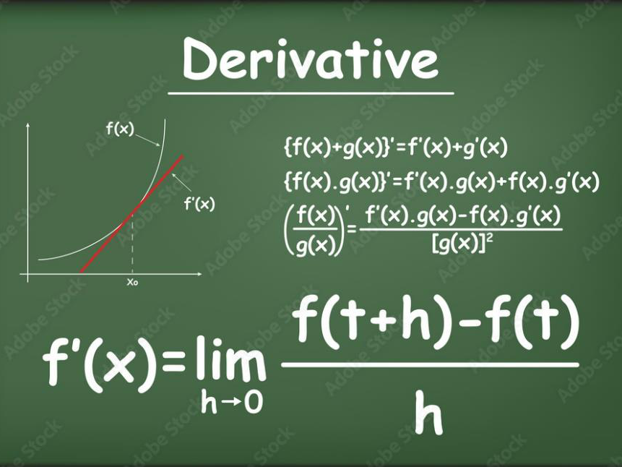

Slide 20
Derivatives:
The derivative of f is another function, denoted f _, which gives the changing slope of the curve y = f 1 x 2. Equivalently, the derivative of f gives the instantaneous rate of change of f at points in the domain.

Slide 21
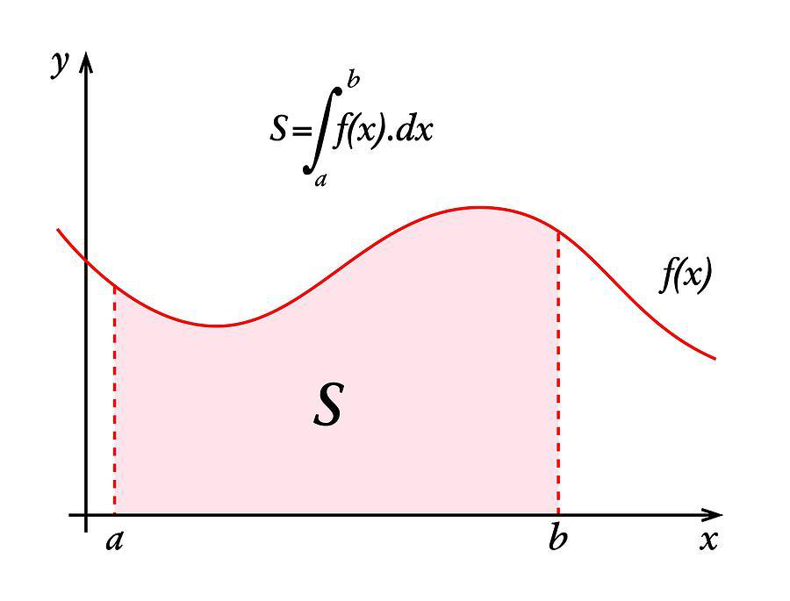

Slide 22
Introducing the Derivative:
If a curve represents the trajectory of a moving object, the line tangent to the curve at a point gives the direction of motion at that point.

Slide 23
Integration:
In this chapter, we develop key properties of definite integrals, investigate a few of their many applications, and present the first of several powerful techniques for evaluating definite integrals. Many would argue that this chapter is the cornerstone of calculus because it explains the relationship between the two processes of calculus: differentiation and integration.

Slide 24
Applications of Integration:
Next, we explore some rich geometric applications of integration: computing the area of regions bounded by several curves, the volume and surface area of three-dimensional solids, and the length of curves.

Slide 25
Velocity and Net Change:
Once we relate velocity and position through integration, we can make analogous observations about a variety of other practical problems, which include fluid flow, population growth, manufacturing costs, and production and consumption of natural resources.

Slide 26
Integration Techniques:
For this reason, we also introduce table-based methods, which are used to evaluate many indefinite integrals, and computer-based methods for approximating definite integrals. Taken altogether, these analytical methods (pencil-and-paper methods) greatly enlarge the collection of integrals that we can evaluate.

